Slide 1
Topic Software evolution and its impact (software configuration management)

Slide 2
Group members Ahad Ali Zafar Saad Rehman Raja Hamza Mehmood Shariq Abbasi

Slide 3
Presented by Ahad Ali Zafar

Slide 4
Introduce the topic "Software Evolution and Its Impact: Software Configuration Management"
Software evolution refers to the process of modifying and improving software systems over time.
It encompasses all the changes made to software, including bug fixes, feature enhancements, performance optimizations, and architectural modifications.

Slide 5
Software Configuration Management (SCM)
Software Configuration Management (SCM) is a discipline within software engineering that focuses on managing and controlling the evolution of software systems

Slide 6
Role in software development and maintenance
Adapting to User Needs
Incorporating New Features
Bug Fixes and Quality Improvements
Performance Optimization
Technology Upgrades
Maintenance and Support
Version Management and Compatibility

Slide 7
The importance of software evolution and its impact on software configuration management (SCM) can be summarized as follows:
Change Management
Version Control
Configuration Management
Collaboration and Teamwork
Traceability and Auditing

Slide 8
Presented by Saad rehman raja

Slide 9
Goals of Software Configuration Management
Ensuring Software Integrity:
One of the main goals of SCM is to ensure the integrity of software throughout its lifecycle. This involves maintaining the consistency, accuracy, and reliability of software artifacts, such as source code, documentation, and configuration files. By enforcing proper version control practices, SCM helps prevent unauthorized or unintended changes to software components.

Slide 10
Traceability: Traceability refers to the ability to track and understand the relationships between different software artifacts and their changes. SCM enables traceability by establishing clear links between requirements, design specifications, code changes, and test cases. Reproducibility: Reproducibility is the ability to recreate or rebuild a specific version of the software at any given point in time. SCM facilitates reproducibility by capturing and managing all the necessary software artifacts and dependencies required to build and deploy the software.

Slide 11
Benefits of implementing SCM
Version Control and Change Management:
improved Collaboration and Team Productivity:
Stability and Software Integrity:
Reproducibility and Release Management
Risk Mitigation and Disaster Recovery
Traceability and Auditing:

Slide 12
Impact of SCM on Software Evolution
Describe how SCM processes and tools facilitate software evolution.
Software Configuration Management (SCM) processes and tools
play a significant role in facilitating software evolution. Here are several
ways in which SCM processes and tools
support the software evolution process:
Version Control
Change Management:
Parallel Development:
Configuration Management:
Release Management:
Traceability and Auditing:

Slide 13
Presented by Hamza Mehmood

Slide 14
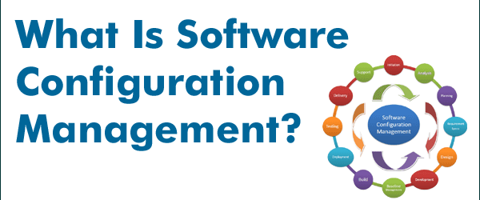
Scm techniques in Software evolution
SCM techniques in software evolution refer to the practices and strategies used in Software Configuration Management (SCM) to effectively manage and control the changes that occur during the evolution of software systems.

Slide 15
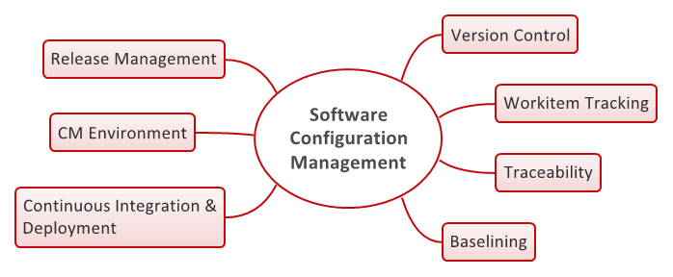
How it supports software evolution
Here are some key SCM techniques that support software evolution and how they contribute to managing the process effectively:
Branching & Merging
Continuous Integration Deployment (CI/CD)
Automated Testing:
Documentation and Communication

Slide 16
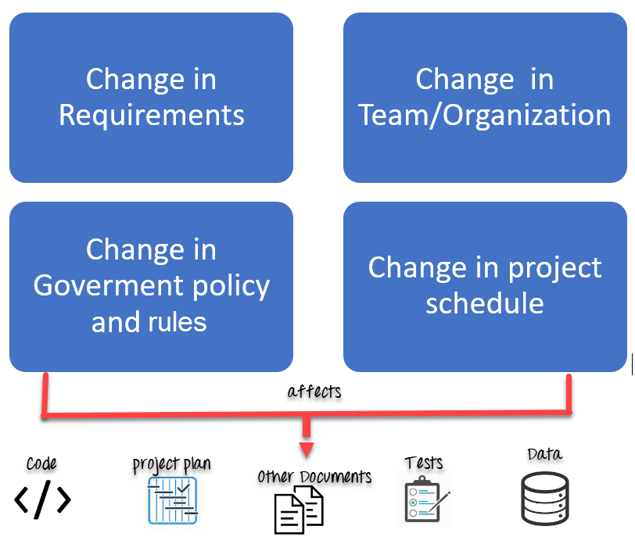
when to implement these Techniques?
When implementing SCM for managing software evolution, it's crucial to follow important best practices to ensure a smooth and effective process. Here are some key best practices to consider:
Establish Version Control as the Foundation
Implement a Consistent and Effective Workflow
Plan and Execute Releases Carefully
Continuously Improve and Learn

Slide 17
Presented by Shariq ABBASI

